Slide 1
NC State University Future Plans Survey: What, when, how, who, and why?
Nancy Whelchel, PhD
Director for Survey Research
Office of Institutional Research and Planning

Slide 2
What is the Future Plans Survey?
Future Plans Survey (FPS) with follow-up Survey of Recent Graduates (SRG)
Developed and administered by the Office of Institutional Research and Planning
In consultation with career center professionals and senior leadership in colleges/departments
For Fall & Spring semester grads since December 2010
FPS/SRG replaced long-standing survey efforts by the Career Development Center

Slide 3
How are the results used? (just a few examples)
Assessment of career services
Academic departments evaluating career-readiness of their students
Academic departments tracking graduate/professional schools attending
Students thinking about majors
[Parents thinking about majors for their student…]
Identifying employers for career fairs
Employers when making salary offers
Students engaged in salary negotiation
Submitted for institutional surveys, rankings, etc.
Voluntary System of Accountability
Supplement NC Tower
Lots, lots more!

Slide 4
The Survey(s)

Slide 5
What information is collected from students?
Deliberately short 5 minute survey to collect detailed information on
Future employment
Company, location, job title, salary, when start the job search, helpful resources in securing employment
Graduate/Professional school attendance
Institution, program, degree, awards/scholarships
Work-experiences at NC State
Participation, helpfulness, use of career services and career fairs
See a copy of the FPS survey instrument here:
https://oirp.ncsu.edu/wordpress/wp-content/uploads/2015/10/fps.may15.Questionnaire.pdf

Slide 6
Who is invited to participate?
Survey population
December & May FPS: Based on Application for Degree file
September SRG: Based on Graduation file from previous academic year
Dec/May FPS non-respondents
Dec/May FPS respondents w/ no confirmed plans
Had not yet found a permanent job; or
Had not been accepted and knew where they would be attending graduate/professional school)
Summer 1 graduates from previous academic year

Slide 7
When is the FPS administered?
The FPS is deliberately administered as close to graduation day as possible in order to get the most up-to-date information from students about their plans
December FPS
First day of exams → mid-January (6 weeks)
May FPS
First day of exams → end of May (4 weeks)

Slide 8
When is the SRG administered?
The SRG is administered in September of the following academic year
8 months after December graduation
3 months after May graduation

Slide 9
How is the survey administered?
Online (Qualtrics)
Access via ‘go.ncsu.edu’ link
Access via QR code
Login with Unity ID
Surveys are confidential, not anonymous
Mobile-friendly

Slide 10
How are students informed about the survey?
Emails*
Invitation: Chancellor
Follow-up 1**: College Dean
Follow-up 2: College Associate Dean for Academic Programs
Follow-up 3: Director of the Career Development Center
Follow-up 4: Office of Institutional Research and Planning
Electronic Bulletin Boards
E.g., Dining halls, C-Stores, bookstore, libraries, academic buildings, residence halls
Flyers
Posted around campus and sent to academic departments
Announcements/information at (some) commencement ceremonies
Information on R&R “Graduation Check-List”
Academic departments encouraged to contact their students…
* The SRG includes on the email invitation and follow-up reminders
** Follow-ups are sent to non-respondents only

Slide 11
E-Board message

Slide 12
Flyer

Slide 13
What incentives are used?
Incentives for each FPS and the SRG
Random drawings for Amazon.com gift cards
8 * $25 for early responders
Graduation day for FPS
@Day 10 for SRG
1 * $100 for all responding by the close of the survey

Slide 14
What about IRB?
IRB Review
Because the FPS & SRG are for internal program assessment purposes they do not meet the federal definition of “research,” and therefore do not fall under the purview of IRB
HOWEVER, OIRP follows all IRB criteria for administering a survey
E.g., equitable selection of survey population, voluntary participation, informed consent (passive), confidentiality, data security, reporting

Slide 15
Response Rates

Slide 16
What is the response rate for the FPS?

Slide 17
How do FPS response rates vary by college?

Slide 18
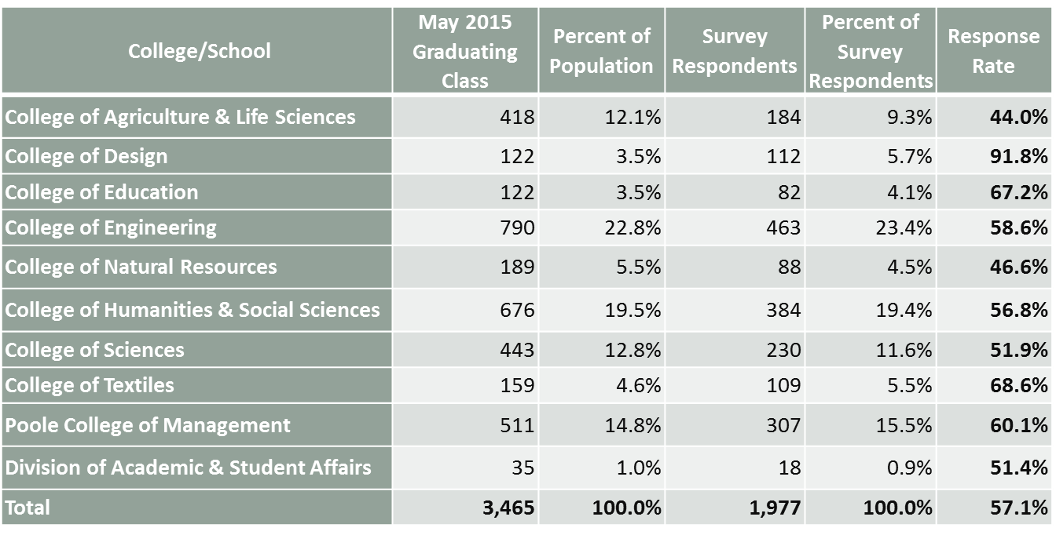
How do FPS response rates vary by college? (an example)
1,977 of the 3,465 applicants for graduation in May 2015 submitted the survey (57%), but response rates varied by college - - meaning that some colleges are slightly overrepresented in results, and some slightly underrepresented

Slide 19
How many alumni are invited to participate in the SRG? (an example)
Just over two-thirds of those graduating in December 2015, just under two-thirds of those graduating in May 2016, and essentially all of those graduating in Summer 1 were asked to participate in the September 2015 SRG
The December and May graduate invitees are twice as likely to be in the population because they did not respond to their FPS than because they did not have confirmed plans when they submitted their FPS
*FPS respondents who indicated that at the time they completed the FPS they had not yet found full-time employment, had not yet decided on or been accepted into graduate school, or were still undecided on their plans.
Semester Graduated | Total Graduates | Invited to take SRG |  |  |  | Total invited to take SRG
 |  | Dec/May FPS Nonrespondents |  | Dec/May FPS Respondents*
 | N | N | % | N | % | N | %
December 2014 | 1,369 | 652 | 47.6% | 303 | 22.1% | 955 | 69.8%
May 2015 | 3,326 | 1,392 | 41.9% | 674 | 20.3% | 2,066 | 62.1%
Summer I 2015 | 171 | 159 | 93.0% | 7 | 4.1% | 166 | 97.1%
Total | 4,866 | 2,203 | 45.3% | 984 | 20.2% | 3,187 | 65.5%

Slide 20
How does the SRG population align with those from the respective graduating classes? (an example)
Those invited to participate in the September 2015 SRG closely mirror the distribution of the graduating classes in AY14-15, with 30% of invitees having graduated in December, 65% in May, and 5% in Summer 1
*FPS respondents who indicated that at the time they completed the FPS they had not yet found full-time employment, had not yet decided on or been accepted into graduate school, or were still undecided on their plans.
Semester Graduated | Total Graduates |  | Invited to take SRG |  |  |  | Total invited to take SRG
 |  |  | Dec/May FPS Nonrespondents |  | Dec/May FPS Respondents*
 | N | % | N | % | N | % | N | %
December 2014 | 1,369 | 28.1% | 652 | 29.6% | 303 | 30.8% | 955 | 30.0%
May 2015 | 3,326 | 68.4% | 1,392 | 63.2% | 674 | 68.5% | 2,066 | 64.8%
Summer I 2015 | 171 | 3.5% | 159 | 7.2% | 7 | 0.7% | 166 | 5.2%
Total | 4,866 | 100% | 2,203 | 100% | 984 | 100% | 3,187 | 100%

Slide 21
What is the response rate for the SRG? (an example)
About one-third of the alumni asked to participate in the September 2015 SRG submitted the survey
Alumni who had previously submitted the FPS (and were unsure of their post-graduation plans at that time) were more than twice as likely as those who had not submitted the FPS to respond to the request to complete the SRG.
*FPS respondents who indicated that at the time they completed the FPS they had not yet found full-time employment, had not yet decided on or been accepted into graduate school, or were still undecided on their plans.
Group | N Invited | N Responding | Response Rate
FPS Respondents* | 977 | 513 | 52.5%
FPS Nonrespondnets | 2,044 | 432 | 21.1%
Summer 1 graduates | 166 | 69 | 41.6%
Total | 3,187 | 1,014 | 31.8%

Slide 22
For what percentage of students graduating in an academic year do we have FPS/SRG data? (an example)
Two-thirds of the AY14-15 graduating seniors completed either the FPS or the SRG, with participation ranging from 55% to 85% for the individual colleges
College/School | AY 14-15 Population |  | FPS/SRG Respondents |  | Response Rate
 | N | % | N | % | %
College of Agriculture and Life Sciences | 564 | 11.6% | 314 | 9.9% | 55.7%
College of Design | 150 | 3.1% | 128 | 4.0% | 85.3%
College of Education | 155 | 3.2% | 110 | 3.5% | 71.0%
College of Engineering | 1,093 | 22.5% | 781 | 24.7% | 71.5%
College of Natural Resources | 322 | 6.6% | 179 | 5.7% | 55.6%
College of Humanities and Social Sciences | 1,000 | 20.6% | 640 | 20.2% | 64.0%
College of Sciences | 613 | 12.6% | 362 | 11.4% | 59.1%
College of Textiles | 205 | 4.2% | 147 | 4.6% | 71.7%
Poole College of Management | 720 | 14.8% | 471 | 14.9% | 65.4%
Division of Academic and Student Affairs | 44 | 0.9% | 30 | 0.9% | 68.2%
Total | 4,866 | 100.0% | 3,162 | 100.0% | 65.0%

Slide 23
What is the final make-up of the survey respondents included in the combined FPS/SRG report? (an example)
In the combined report for AY14-15, about one-third of the responses are from those who submitted the SRG (evenly divided between those who had not responded to their FPS and those who did not have confirmed post-graduation plans when they submitted their FPS), half of the responses are from the May FPS, and 18% from the December FPS.
Survey Results Included in Report | Graduated December 2014 |  | Graduated May 2015 |  | Graduated Summer I 2015 |  | Total
 | N | % | N | % | N | % | N | %
December FPS | 570 | 68.0% | 0 | 0.0% | 1 | 1.5% | 571 | 18.1%
May FPS | 0 | 0.0% | 1,569 | 69.6% | 8 | 11.6% | 1,577 | 49.9%
September SRG | 268 | 32.0% | 686 | 30.4% | 60 | 87.0% | 1,014 | 32.1%
September SRG: FPS respondent | 145 | 17.3% | 365 | 16.2% | 3 | 4.3% | 513 | 16.2%
September SRG: FPS nonrespondent | 123 | 14.7% | 321 | 14.2% | 57 | 82.6% | 501 | 15.8%
Total | 838 | 26.5% | 2,255 | 70.4% | 69 | 2.2% | 3,162 | 100%

Slide 24
Sharing the Results

Slide 25
What reports are provided for the FPS?
Online https://oirp.ncsu.edu/may-2015-future-plans-survey
Methods & Response Rates
Detailed tables/charts of results for all respondents, with text summaries
Detailed tables of results for most questions by college
College summary tables
Results by department
Response rate
N w/ full-time job
N going to grad/prof school
Salary (25th percentile, median, 75th percentile, average)
Employment information
Company, location, job title, helpful resources
Graduate/professional school information
Institution, location, degree, program
Questionnaire

Slide 26
What reports are provided for the FPS? (continued)
Interactive point and click interface (May FPS only) http://apps.oirp.ncsu.edu/pgem/index.cfm?action=main.summary
College, department, academic program results
Response rates
N Attending graduate/professional school
N w/ full-time job
N reporting salary
Average and median starting salary

Slide 27
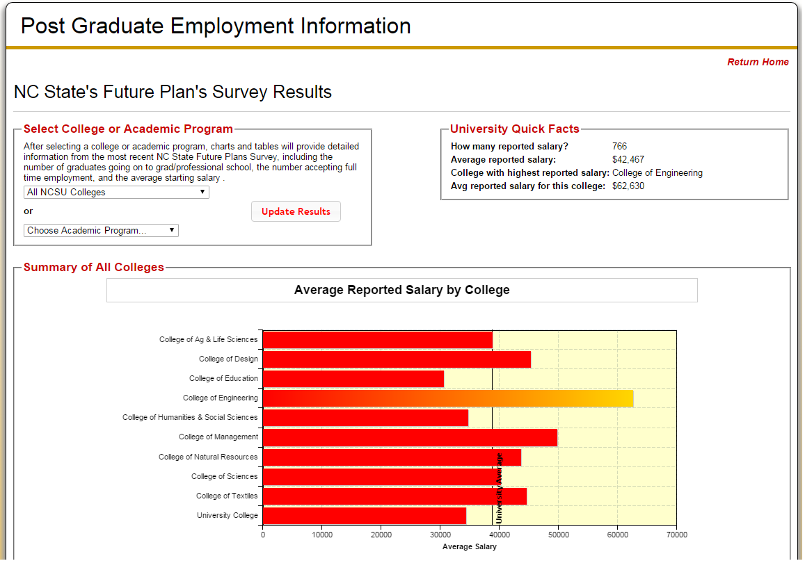

Slide 28
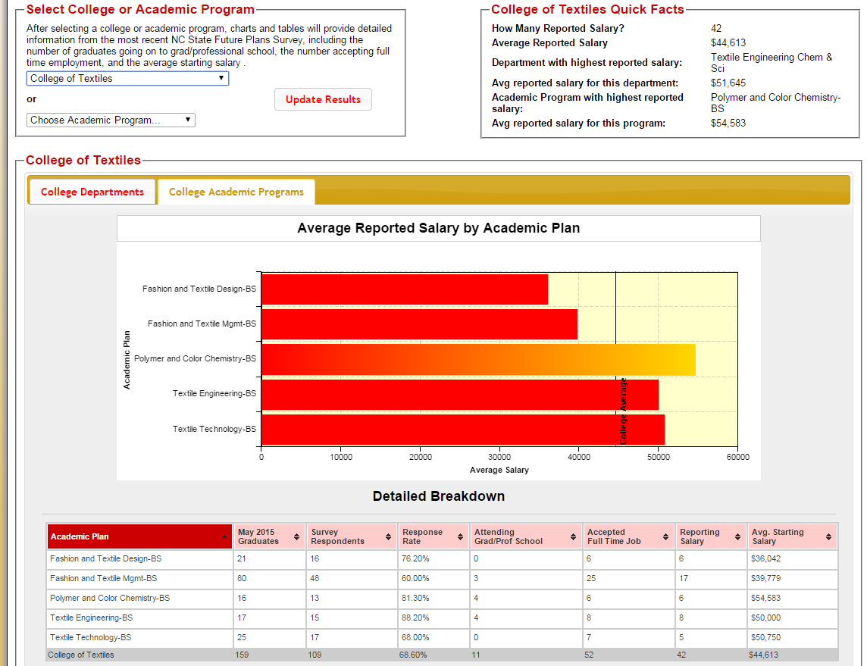

Slide 29
What reports are provided for the FPS? (continued)
Excel files w/ data and documentation
Provided directly to Career Development Center and to respective Colleges/Departments
Unit record results
1 record per person
Responses to all closed-end questions
Recoded and/or cleaned
Responses to all open-end questions (cleaned)
Demographic information
College, department, plan (major), subplan
Codebook

Slide 30
What reports are provided for the SRG?
None…

Slide 31
What reports are provided for the combined FPS and SRG?
Online reports for the academic year FPS & SRG combined results
(see https://oirp.ncsu.edu/academic-year-2014-2015-combined-future-plans-survey-survey-of-recent-graduates)
Combines results from Dec/May FPS & Sept SRG
Uses data from most recent survey if respondent completed both the FPS and SRG
Research Methods & Response Rates
Detailed tables of results for all respondents, with text summaries
Detailed tables of results by college
Department summaries, by college

Slide 32
What reports are provided for the combined FPS and SRG? (continued)
Excel files w/ data and documentation for the academic year FPS & SRG combined results
Includes data from most recent survey if respondent completed both the FPS and SRG
Provided directly to Career Development Center and to respective Colleges/Departments
Unit record results
1 record per person
Responses to all closed-end questions
Recoded and/or cleaned
Responses to all open-end questions (cleaned)
Demographic information
College, department, plan (major), subplan
Codebook

Slide 33
How else do we share the information and get feedback/input on the FPS/SRG?
Presentations on results
Annually to career development professionals across campus
Executive Officers
Deans
Others on request

Slide 34
How else do we share the information and get feedback/input on the FPS/SRG? (continued)
Regular discussions with career development professionals and others on
Research design
Survey population
Questionnaire
Messaging
Strategies for increasing participation
Reporting the results (what, to whom, how, etc.)
Increasing awareness on campus about the survey and data available
Understanding and using the results
Etc.

Slide 35
What else would we like to do? A random list…
Better use of social media to encourage participation in the survey
Announcement(s) about survey w/ invitation to participate at University graduation ceremony (e.g., in commencement book, on big screen, flyers)
Articles promoting the survey and on results in campus media (for students, faculty, and staff)
Have participation connected directly to graduation processes (e.g., requirements…)
Scale-up project and distribute at other campuses
Peer comparisons (not just, e.g., from the College Scorecard or NC Tower…)

Slide 36
Want more information?
https://oirp.ncsu.edu/surveys/survey-reports/studentalumni-surveys/future-plans-survey-and-survey-of-recent-graduates
Contact:
Nancy Whelchel, Director for Survey Research
Office of Institutional Research and Planning
nancy_whelchel@ncsu.edu

