Slide 1
Administrative Leadership Meeting
Tuesday, Sept. 15, 2015
Chancellor Randy Woodson

Slide 2
Upcoming ALM Topics
Nov. 10
Strategic Plan Report Card Update
(Titmus Theatre)

Slide 3
Budget Update

Slide 4
U.S. News & World Report Rankings
89th in National Universities Ranking (up from 95th last year)
37th in Public National Universities (up from 43rd)
31st in Undergraduate Engineering programs (same as last year)
50th in Best Value "Great Schools, Great Prices" (down from 46th)
25th in Least Debt Load at Graduation (down from 20th)
82nd among Online Degree Programs
93rd among Best Business Programs

Slide 5
Coming up
The State of NC State
Fall Address
Monday, Oct. 5
10 a.m.
Stewart Theatre
Talley Student Union

Slide 6
Also of Note
Campaign
Work is underway to establish a Faculty and Staff Giving Program. More information coming soon.
Also in development: an Employee Dependent Tuition Scholarship that will be available for students of NC State Employee's.
The State Employee's Combined Campaign (SECC)
This will now be managed through the Department of Human Resources. You will be hearing from them in the near future with more details.

Slide 7
Transitions
Alan Rebar – VC, Research, Innovation & Economic Development
Bill Ditto – Dean, College of Sciences
Francine Cronin – Assoc. VC, University Development
Charlie Leffler’s final ALM
Mary Peloquin-Dodd – Interim VC, Finance & Administration

Slide 8
Strategic Resource Management
Warwick Arden, Provost and Executive Vice Chancellor
Charles D. Leffler, Vice Chancellor, Finance and Administration

Slide 9
Strategic Resource Management: 2013
Chancellor charged Provost and VC for Finance and Administration (Fall 2013)
Convened SRM working group
Chairs Duane Larick and Ginger Burks Draughon
Invited campus to submit ideas via go.ncsu.edu/ideas
Reviewed issues related to:
Cost containment
Reallocation
New revenue growth
Improved operational efficiency

Slide 10
Strategic Resource Management: 2014-2015
Spring/Summer 2014
Approved Phase I recommendations
Charged Phase I implementation teams
Spring/Summer 2015
Approved Phase II recommendations
Charged Phase II implementation teams
Today
Phase I and Phase II updates and progress
go.ncsu.edu/srm

Slide 11
Phase I Recommendations
A: Common Internal Allocation Method | B: Differential/ Premium Tuition & Fees | C: Growth of Doctoral Education | D: Internal Transfer
Common internal allocation method for enrollment-related academic funds | Premium tuition for targeted master’s programs COE program enhancement fee | Expand doctoral stipend program, incentivize faculty to include stipends in grants, revise GSSP Monitor college resource/position cuts, graduate student insurance, student support in capital campaign Doctoral enrollment market analysis | Manage all transfer admissions centrally, analyze capacity drivers/ resource constraints for high demand programs Consider University College model

Slide 12
Phase I Recommendations
A: Common Internal Allocation Method | B: Differential/ Premium Tuition & Fees | C: Growth of Doctoral Education | D: Internal Transfer
Common internal allocation method for enrollment-related academic funds | Premium tuition for targeted master’s programs COE program enhancement fee | Expand doctoral stipend program, incentivize faculty to include stipends in grants, revise GSSP Monitor college resource/position cuts, graduate student insurance, student support in capital campaign Doctoral enrollment market analysis | Manage all transfer admissions centrally, analyze capacity drivers/ resource constraints for high demand programs Consider University College model

Slide 13
Common Internal Allocation Method for Enrollment-related Academic Funds
Recommendation:
NC State needs a uniform course funding allocation system to units delivering on-campus and DE courses that is independent of the method of delivery.
Charge to Budget Restructuring Task Force:
Evaluate the current allocation methodologies for academic funds related to the delivery of new (i.e., additional) credit hours of instruction to students
Develop one consistent internal resource allocation methodology for enrollment change-related academic funds

Slide 14
Budgeted Enrollment Expansion
Net
$7,457,388
Net
$(288,119)

Slide 15
Review of Internal Allocation Options
Distribution to Colleges
Enrollment change-related academic funds
SCH change per 12-cell matrix w/ NC State BATS* | SCH change per 12-cell matrix w/ college BATS*
SCH change per 12-cell matrix w/ NC State BATS* + headcount component | SCH change per 12-cell matrix w/ college BATS* + headcount component
%
%
Strategic Initiatives
*BATS: Budgeted Average Teaching Salary

Slide 16
Recommended Internal Allocation Model
Enrollment Change-related Academic Funds
2015-16 Using model to inform process
Strategic Initiatives
Colleges
2016-17 Implementing model
50%
50%
Funds to colleges based on:
Projected enrollment change in SCHs as compared to prior year’s target
BATS for each college (2 digit OUC) that is eligible for an allocation

Slide 17
Phase I Recommendations
A: Common Internal Allocation Method | B: Differential/ Premium Tuition & Fees | C: Growth of Doctoral Education | D: Internal Transfer
Common internal allocation method for enrollment-related academic funds | Premium tuition for targeted master’s programs COE program enhancement fee | Expand doctoral stipend program, incentivize faculty to include stipends in grants, revise GSSP Monitor college resource/position cuts, graduate student insurance, student support in capital campaign Doctoral enrollment market analysis | Manage all transfer admissions centrally, analyze capacity drivers/ resource constraints for high demand programs Consider University College model

Slide 18
Premium Tuition for Targeted Master’s Programs
Which programs should have premium tuition?
What are the selection criteria?
What’s required for a proposal?
Creating two documents:
Protocol and Timeline for Premium Tuition Proposals
Guide to Writing a Proposal for Premium Tuition
Increased tracking and reporting requirements
Discussions on coverage of administration costs

Slide 19
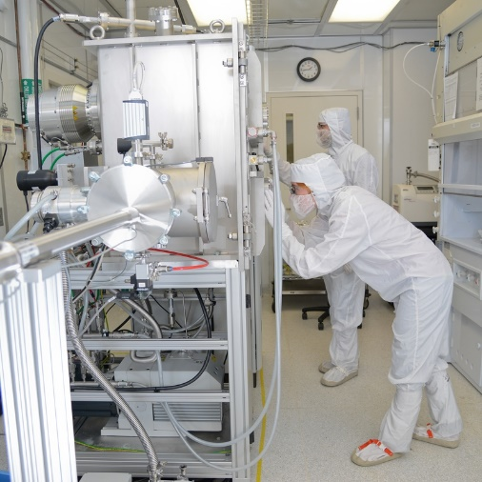
COE Program Enhancement Fee
Program Enhancement Fee for
innovative educational experiences
investments in new and existing infrastructure and critical upgrades to laboratories and equipment
Charged to all engineering students (UG and graduate)
$500 in 2015-16, $1,000 in 2016-17
Projected revenues: $4.4M in 2015-16, $8.8M in 2016-17

Slide 20
Phase I Recommendations
A: Common Internal Allocation Method | B: Differential/ Premium Tuition & Fees | C: Growth of Doctoral Education | D: Internal Transfer
Common internal allocation method for enrollment-related academic funds | Premium tuition for targeted master’s programs COE program enhancement fee | Expand doctoral stipend program, incentivize faculty to include stipends in grants, revise GSSP Monitor college resource/position cuts, graduate student insurance, student support in capital campaign Doctoral enrollment market analysis | Manage all transfer admissions centrally, analyze capacity drivers/ resource constraints for high demand programs Consider University College model

Slide 21
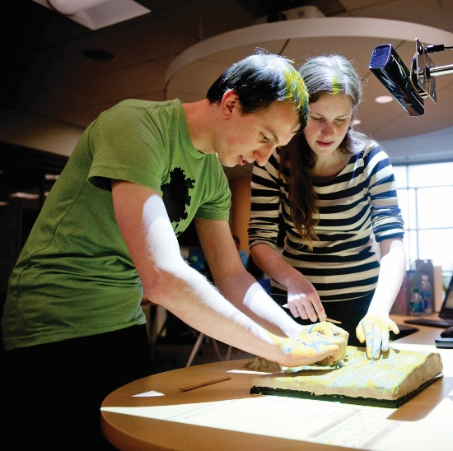
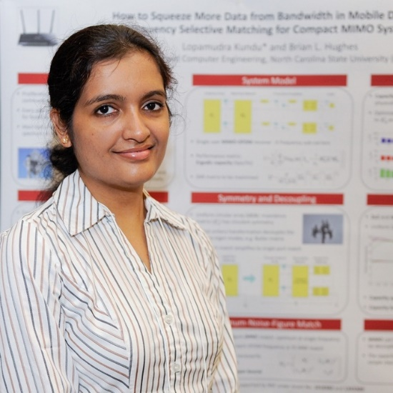
Growth of Doctoral Education: Major Topics
Faculty incentive programs (financial and support-based)
Revising the Graduate Student Support Program (GSSP)
First year internal fellowship programs
External and NC State foundation fellowships

Slide 22
Graduate Assistantships and Fellowships

Slide 23
Growth of Doctoral Education: Faculty Incentive Ideas
Submit and Manage Training Grants | Include Doctoral Research Stipends on Grants
Proposal development and management support Matching stipends Supplement some grants (e.g. NIH) to be competitive | Possible F&A supplement Eliminating the requirement to pay 25% of tuition remission Carry-over funding in case grant expires

Slide 24
Revising the GSSP: Goals
Make more affordable via revised plan for Master’s programs and Master’s student participation
Enhance student success by insuring coverage throughout graduate program
Evaluate funding to insure availability of funding as graduate education, especially doctoral education, grows.

Slide 25
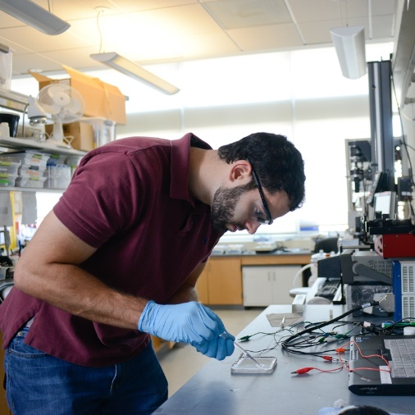
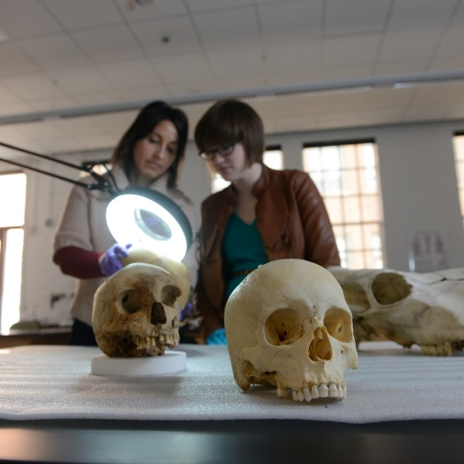
Revising the GSSP: Ideas
Increase funding by provost in proportion to PhD enrollment increase
Increase minimum stipend to qualify for benefits or index to inflation
Allow additional flexibility in eligibility for PhD students
Reduce benefits for Master’s students
Earmark portion of enrollment increase funding, CITI and F&A for GSSP

Slide 26
First-year Internal Fellowships
Provost’s Doctoral Fellowships - one-time stipends targeting enrollment growth in programs with:
Capacity for enrollment growth (faculty, space, etc.), capacity to provide research funding to convert students to external funding in year 2+, and ability to maximize return on investment
Continue University recruiting supplements funded by the Provost and ORIED for top students
Fall 2014 | Fall 2015 | Fall 2016
60 recruiting stipends offered | 67 recruiting stipends allocated | Up to 100 recruiting stipends proposed

Slide 27
External & NC State Foundation Fellowships
Include graduate fellowships in upcoming campaign
Maximize admissions of internationally funded students
Encourage PIs to pursue add-on grant opportunities
Training faculty and advisors to pursue externally funded fellowships
Develop international partnerships
Consider challenges that GSSP rules may create
Maximize use of the Fellowship Advising Office
Funding may be available for an additional, related purpose not specified in original grant

Slide 28
Growth of Doctoral Education: Other Efforts
Protect graduate student stipend funding from budget cuts
Petition the UNC System to allow NC State graduate students to be moved into UNC System insurance plan
Conduct doctoral enrollment market analysis to explore opportunities for growth in strategic areas

Slide 29
Phase I Recommendations
A: Common Internal Allocation Method | B: Differential/ Premium Tuition & Fees | C: Growth of Doctoral Education | D: Internal Transfer
Common internal allocation method for enrollment-related academic funds | Premium tuition for targeted master’s programs COE program enhancement fee | Expand doctoral stipend program, incentivize faculty to include stipends in grants, revise GSSP Monitor college resource/position cuts, graduate student insurance, student support in capital campaign Doctoral enrollment market analysis | Manage all transfer admissions centrally, analyze capacity drivers/ resource constraints for high demand programs Consider University College model

Slide 30
Centralize Internal and External Transfer Admissions
Transfer admission process was centralized through Enrollment Management and Services in the June 2015 cycle
Allows for better coordination of freshman, internal transfers and external transfers, which is critical to an effective enrollment management process
Increased dialogue between academic colleges/departments and central administration
Internal transfer requirements are evolving to ensure they can be met in a timely manner and are correlated with student success
"Constrained" majors are evaluating existing requirements and enrollment management practices
The new process is more efficient and transparent for students

Slide 31
University College
DASA internal reorganization in July 2015 - University College replaced Academic Program and Services unit
Seeks to promote the academic success of all students
Academic Advising, including Exploratory Studies
Academic Administration & Curricula
Academic Enhancement Programs
Academic Departments & Programs
Academic Success Cluster
Academic Support Program for Student Athletes

Slide 32
Phase II Recommendations
A: Evaluation of Satellite and Off-campus Facilities | B: Evaluation of Self-Supporting Programs | C: Position Analysis, Budgeting and Tracking | D: Specific Opportunities for Outsourcing
Equine facilities assessment Minerals Research Laboratory CALS off-campus facilities Center for Marine Sciences and Technology | Upper Ledger 3 project analysis Analysis of self-supporting entity reimbursement | Position standardization in PeopleSoft HR and Financials | Outsourcing small-scale projects and expansion of facilities convenience contractor program Motor pool evaluation
Recommendations due Winter 2015 | Update in Fall 2015 | Update in Fall 2015 | Update in Fall 2015

Slide 33
Phase II Recommendations
A: Evaluation of Satellite and Off-campus Facilities | B: Evaluation of Self-Supporting Programs | C: Position Analysis, Budgeting and Tracking | D: Specific Opportunities for Outsourcing
Equine facilities assessment Minerals Research Laboratory CALS off-campus facilities Center for Marine Sciences and Technology | Upper Ledger 3 project analysis Analysis of self-supporting entity reimbursement | Position standardization in PeopleSoft HR and Financials | Outsourcing small-scale projects and expansion of facilities convenience contractor program Motor pool evaluation
Recommendations due Winter 2015 | Update in Fall 2015 | Update in Fall 2015 | Update in Fall 2015

Slide 34
Evaluation of Satellite and Off-campus Facilities
Equine Facilities – College of Veterinary Medicine
Evaluate off-site equine facilities and establish an NC State-based equine training facility in partnership with College of Agriculture and Life Sciences
Recommendation due Winter 2015
Minerals Research Laboratory – College of Engineering
Analyze use of self-generated funds within MRL's budget and if 16030 funds can be freed up to be used for college in other way
Recommendation due Winter 2015

Slide 35
Evaluation of Satellite and Off-campus Facilities
CALS Off-Campus Facilities
Evaluate Marine Aquaculture Research Center to identify related expenditures within CALS budget and determine whether should continue investment or use resources another way to best support CALS strategic plan.
Explore potential enhanced use of NC Research Campus facility and equipment by other colleges.
Recommendation due Winter 2015

Slide 36
Evaluation of Satellite and Off-campus Facilities
Center for Marine Sciences and Technology
Review UNC-General Administration’s upcoming Coastal and Marine Sciences Assessment
Evaluate assessment, its effect on CMAST, and next steps
Report 60 days following release of UNC-GA report

Slide 37
Phase II Recommendations
A: Evaluation of Satellite and Off-campus Facilities | B: Evaluation of Self-Supporting Programs | C: Position Analysis, Budgeting and Tracking | D: Specific Opportunities for Outsourcing
Equine facilities assessment Minerals Research Laboratory CALS off-campus facilities Center for Marine Sciences and Technology | Upper Ledger 3 project analysis Analysis of self-supporting entity reimbursement | Position standardization in PeopleSoft HR and Financials | Outsourcing small-scale projects and expansion of facilities convenience contractor program Motor pool evaluation
Recommendations due Winter 2015 | Update in Fall 2015 | Update in Fall 2015 | Update in Fall 2015

Slide 38
Evaluation of Self-Supporting Programs
Upper Ledger 3
Conduct strategic alignment and financial review of 25-30 Upper Ledger 3 projects designated as Auxiliary Sales & Services or Service Centers
Recommendation due Winter 2015
Self-Supporting Entities
Analyze self-supporting entities and supporting resources to determine if they should reimburse university for overhead costs (e.g., space, utilities)
Report due Fall 2015

Slide 39
Phase II Recommendations
A: Evaluation of Satellite and Off-campus Facilities | B: Evaluation of Self-Supporting Programs | C: Position Analysis, Budgeting and Tracking | D: Specific Opportunities for Outsourcing
Equine facilities assessment Minerals Research Laboratory CALS off-campus facilities Center for Marine Sciences and Technology | Upper Ledger 3 project analysis Analysis of self-supporting entity reimbursement | Position standardization in PeopleSoft HR and Financials | Outsourcing small-scale projects and expansion of facilities convenience contractor program Motor pool evaluation
Recommendations due Winter 2015 | Update in Fall 2015 | Update in Fall 2015 | Update in Fall 2015

Slide 40
Position Analysis, Budgeting and Tracking
Identify system tools to analyze requests for new position funding that can be used by all units
Provide additional campus training to track positions at the department level
Identify differences between PeopleSoft HR and PeopleSoft Financials and standardize for more accurate reporting
In progress; Update in Fall 2015

Slide 41
Phase II Recommendations
A: Evaluation of Satellite and Off-campus Facilities | B: Evaluation of Self-Supporting Programs | C: Position Analysis, Budgeting and Tracking | D: Specific Opportunities for Outsourcing
Equine facilities assessment Minerals Research Laboratory CALS off-campus facilities Center for Marine Sciences and Technology | Upper Ledger 3 project analysis Analysis of self-supporting entity reimbursement | Position standardization in PeopleSoft HR and Financials | Outsourcing small-scale projects and expansion of facilities convenience contractor program Motor pool evaluation
Recommendations due Winter 2015 | Update in Fall 2015 | Update in Fall 2015 | Update in Fall 2015

Slide 42
Specific Opportunities for Outsourcing
Facilities
Outsource small-scale projects with limited scope of work using authorized list of providers
Expand Facilities pilot program for use of convenience contractor
In progress; Update in Fall 2015
Motor Pool
Evaluate alternatives to Motor Pool self-operation, including rental companies and personal vehicle reimbursement
In progress; Update in Fall 2015

Slide 43
Continuing Our Progress
Future opportunities
Goal 4: Enhance organizational excellence by creating a culture of constant improvement
SRM info and updates will be posted to: go.ncsu.edu/srm

